Slide 1
To Catch a Frog
By: Ms. Kaim

Slide 2
I love frogs! I love to watch them swimming, jumping, and eating. I love looking for their eyes peeking out of the water. I love to hear them croaking in the evenings and peeping in the spring. I love everything about frogs, but I have never held a frog in my hands.
That is why I decided to catch a frog!

Slide 3
I grabbed a bucket and a net with a long handle. Frogs live in or near water so I began looking for them by rivers and ponds. After searching in vain for a long time, I almost gave up. But I love frogs, so I continued my mission. My persistence finally paid off. I spotted a frog!

Slide 4
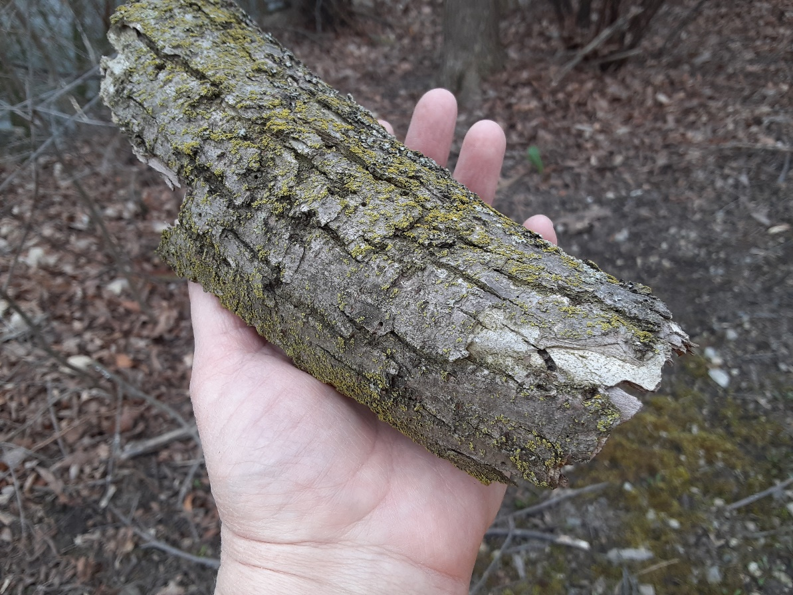
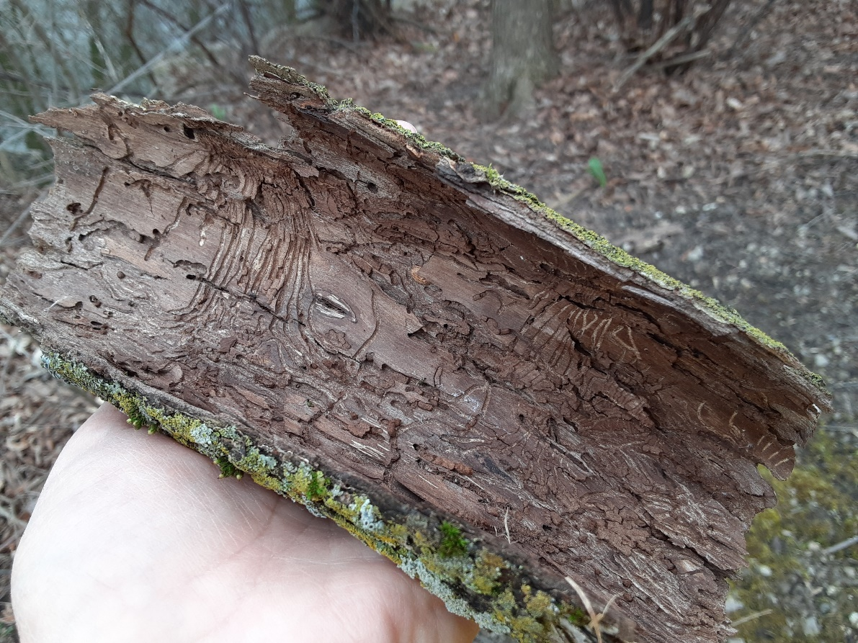
I think the frog saw me, too, because he hopped under this piece of bark. When I turned the bark over, the frog was gone! Where did he go?

Slide 5
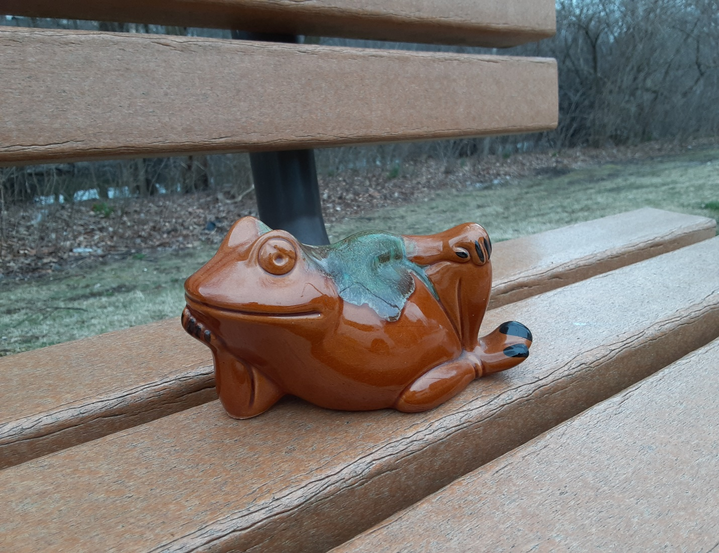
Aha! There he was! But, wait a minute, this frog appeared to be lounging on the bench and smiling at me.

Slide 6
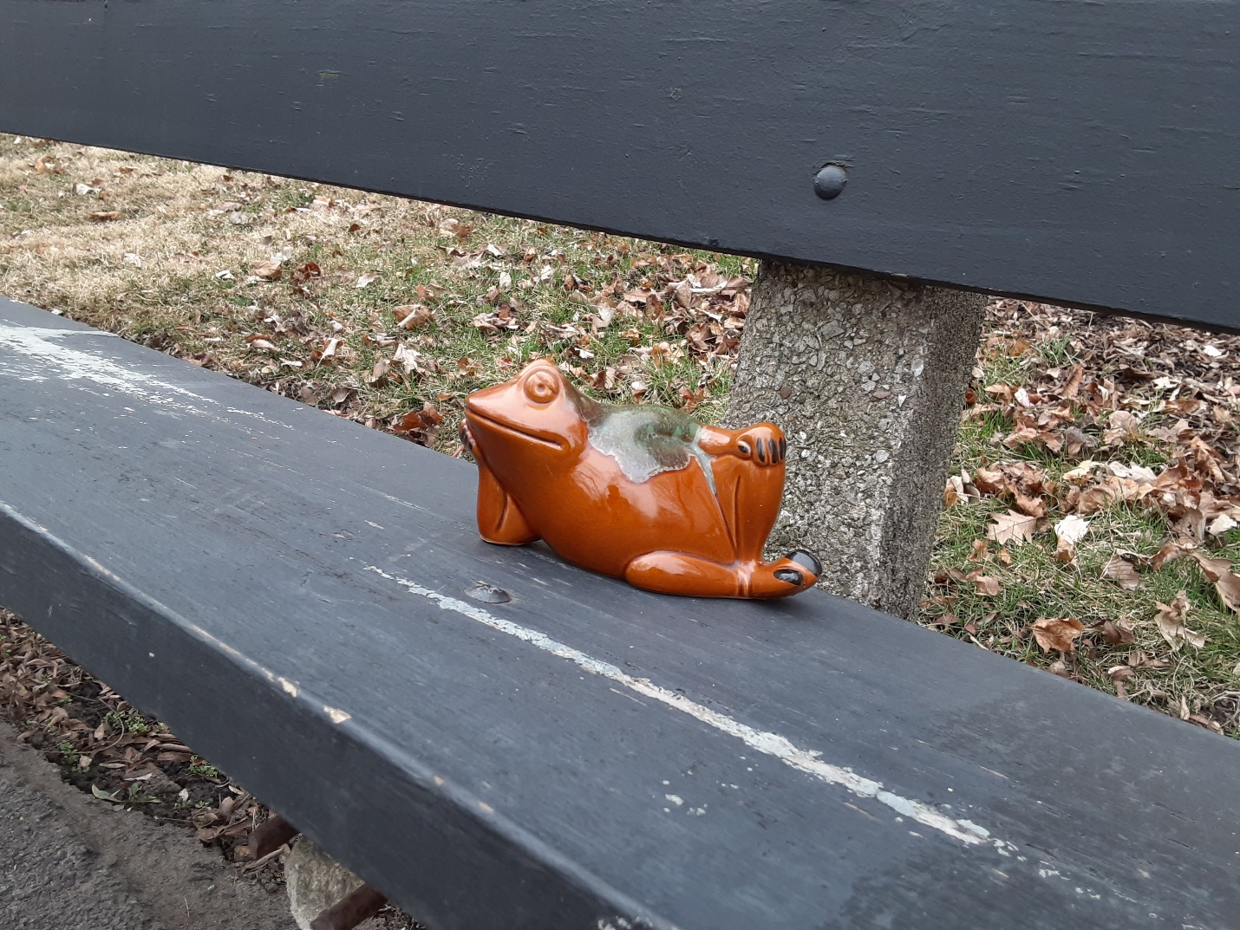
As I moved closer, he hopped over to another bench.

Slide 7
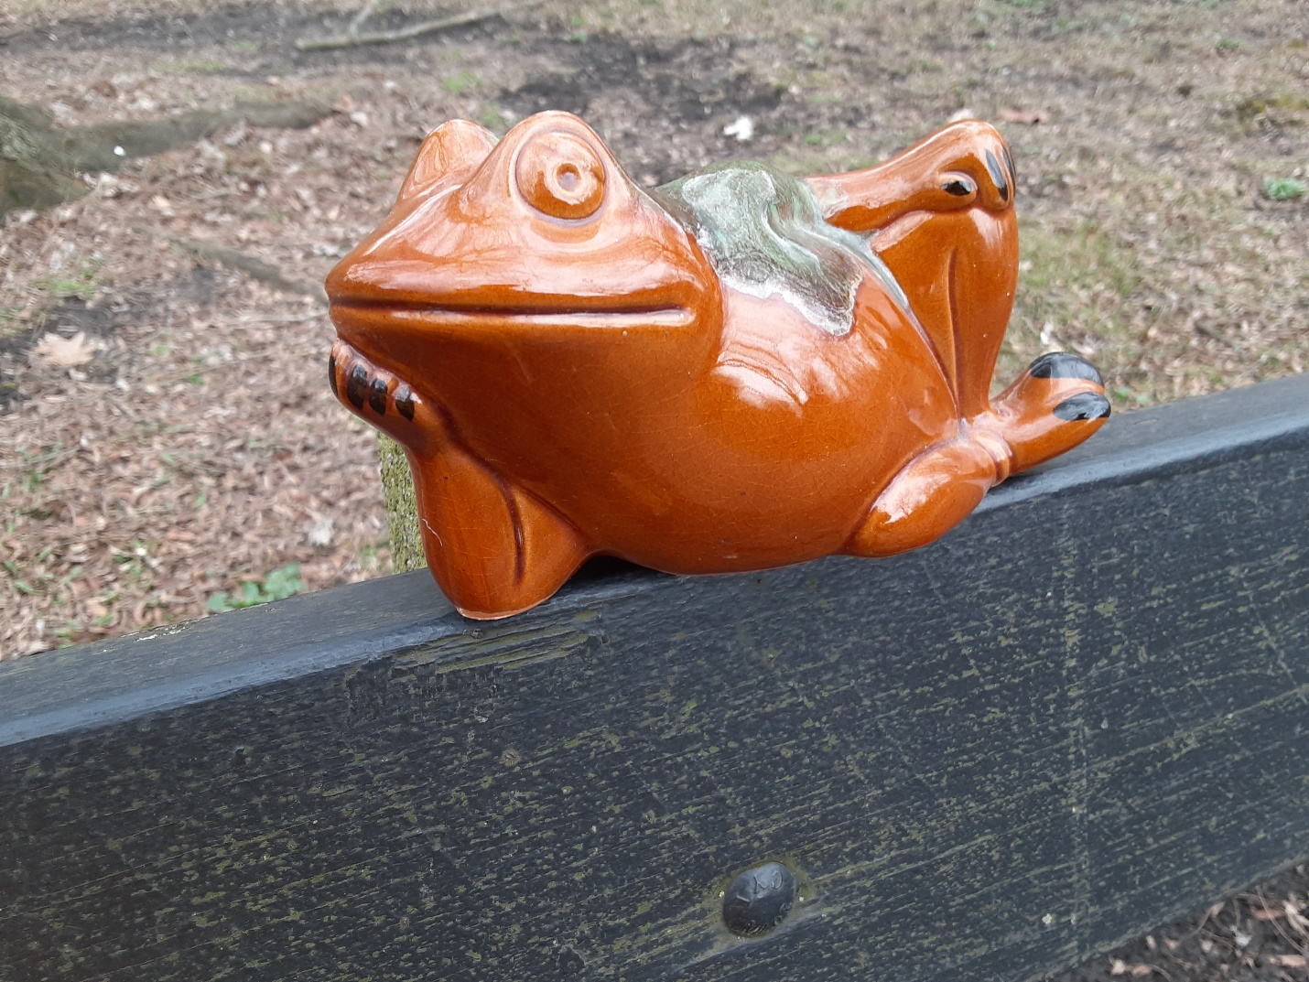
He let me get a really close look at him. This was my chance! I swooped down with my net…

Slide 8
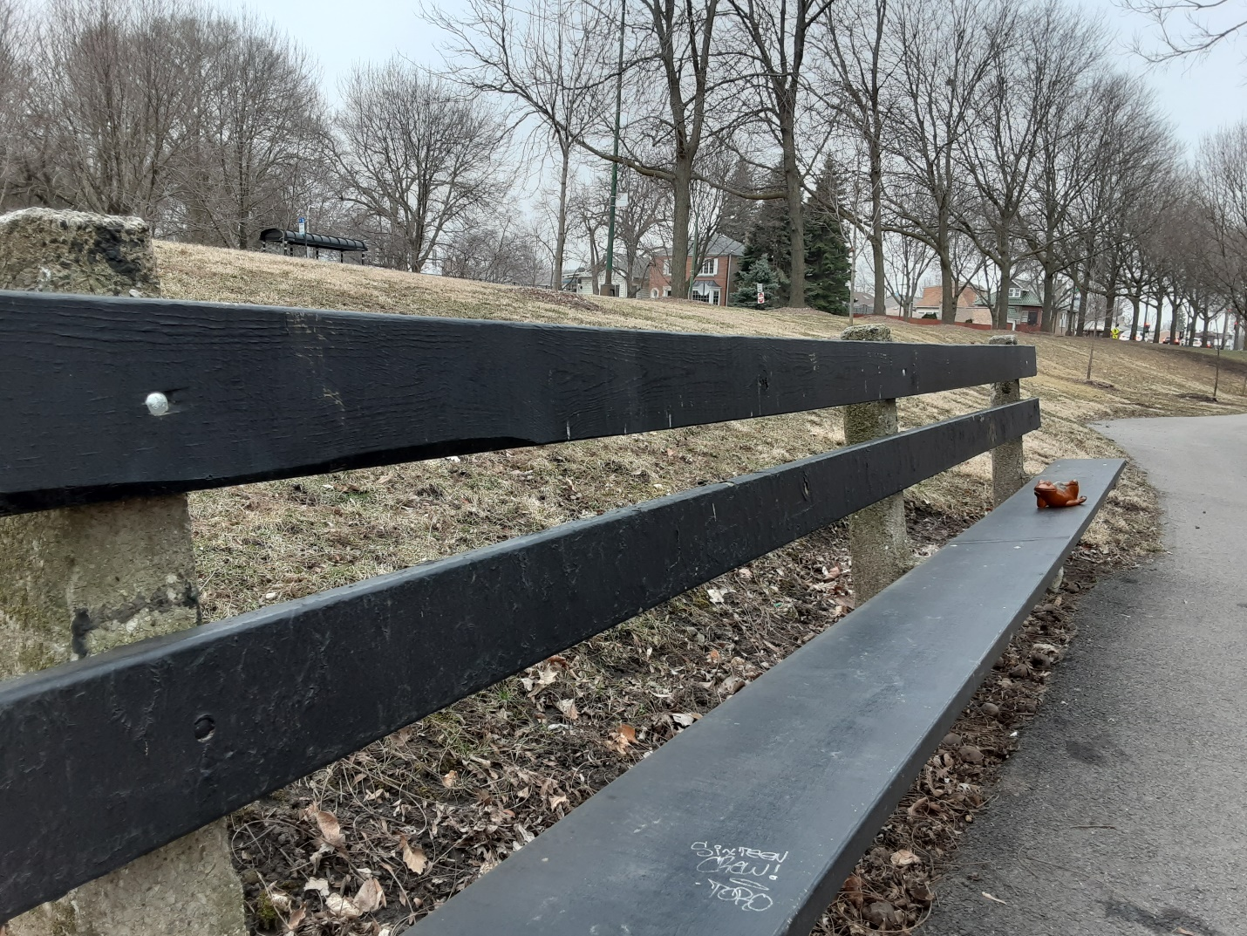
…and he jumped all the way down to the other end of the bench!
The game was on! I was determined to catch this frog.

Slide 9
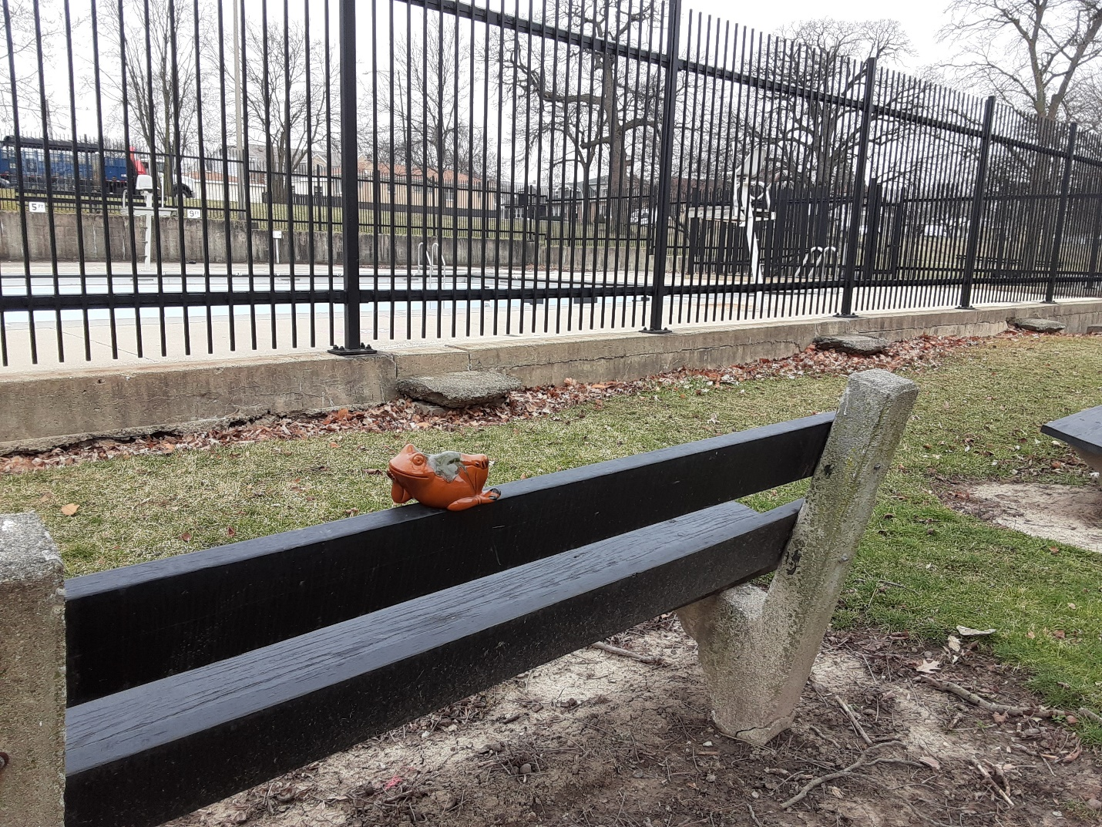
I ran towards him, but the frog quickly jumped over to the swimming pool. He didn’t stay there long!

Slide 10
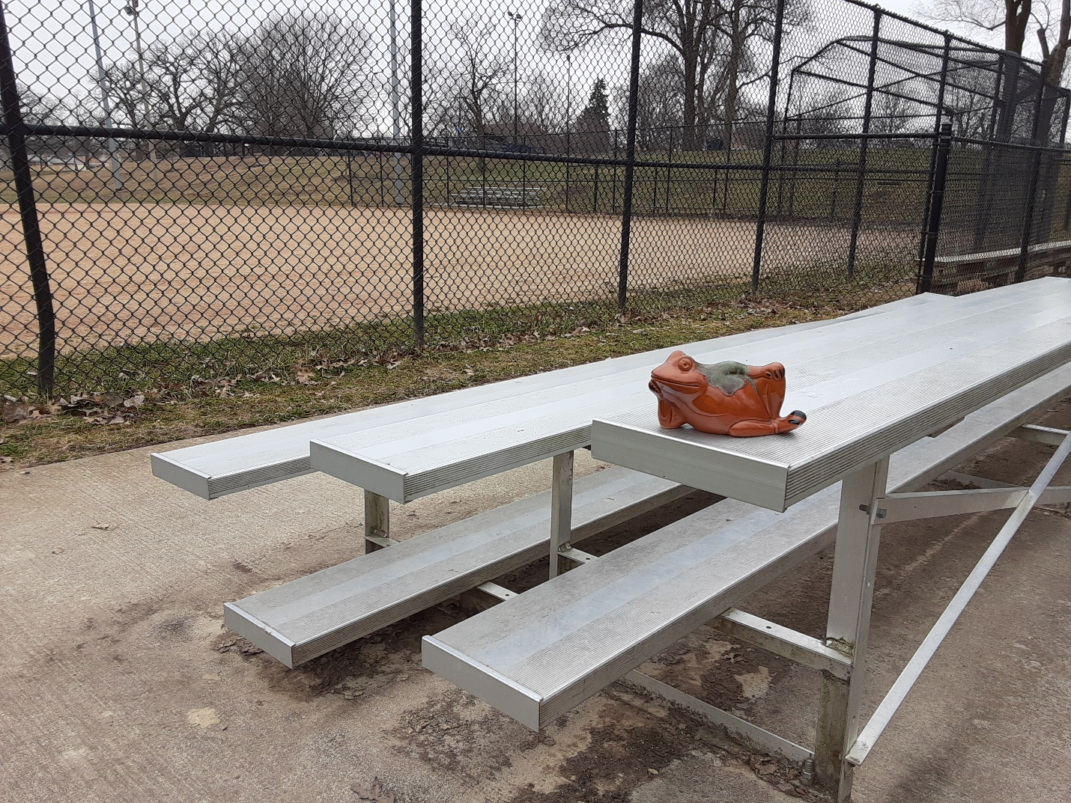
I tried grabbing him, but he leapfrogged over me and onto the bleachers.
I rushed forward with my net again. He just smiled at me as he hopped away.

Slide 11
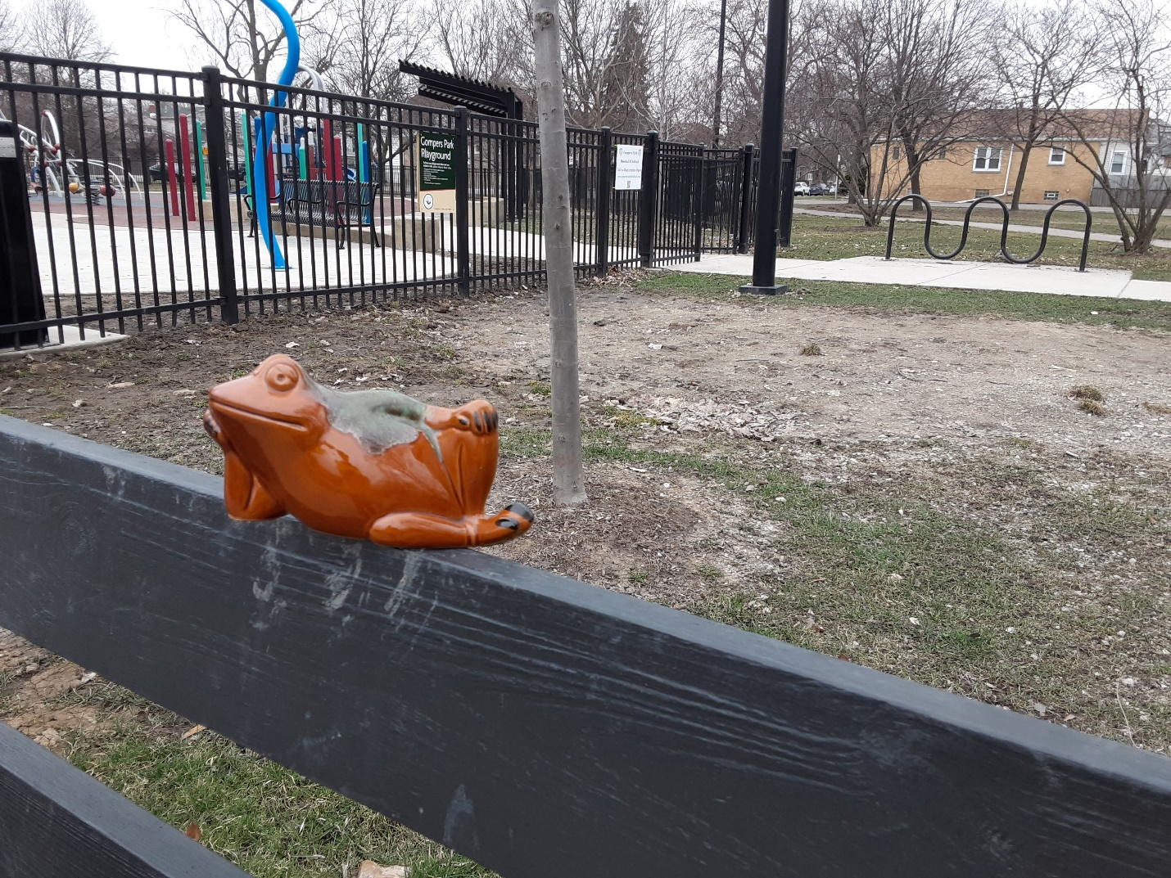
This time, I tiptoed over to that tricky frog. I thought I could plop my bucket on top of him. Quick as a wink, he …

Slide 12
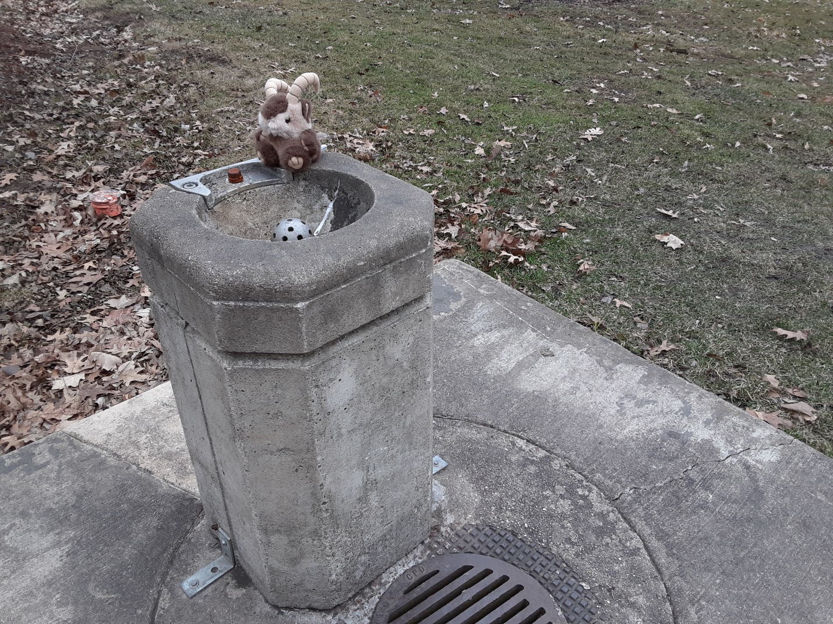
…scurried off and sat down in a drinking fountain. Hold on. That’s not him. It’s a thirsty goat! That little frog is even more elusive than I thought he was!

Slide 13
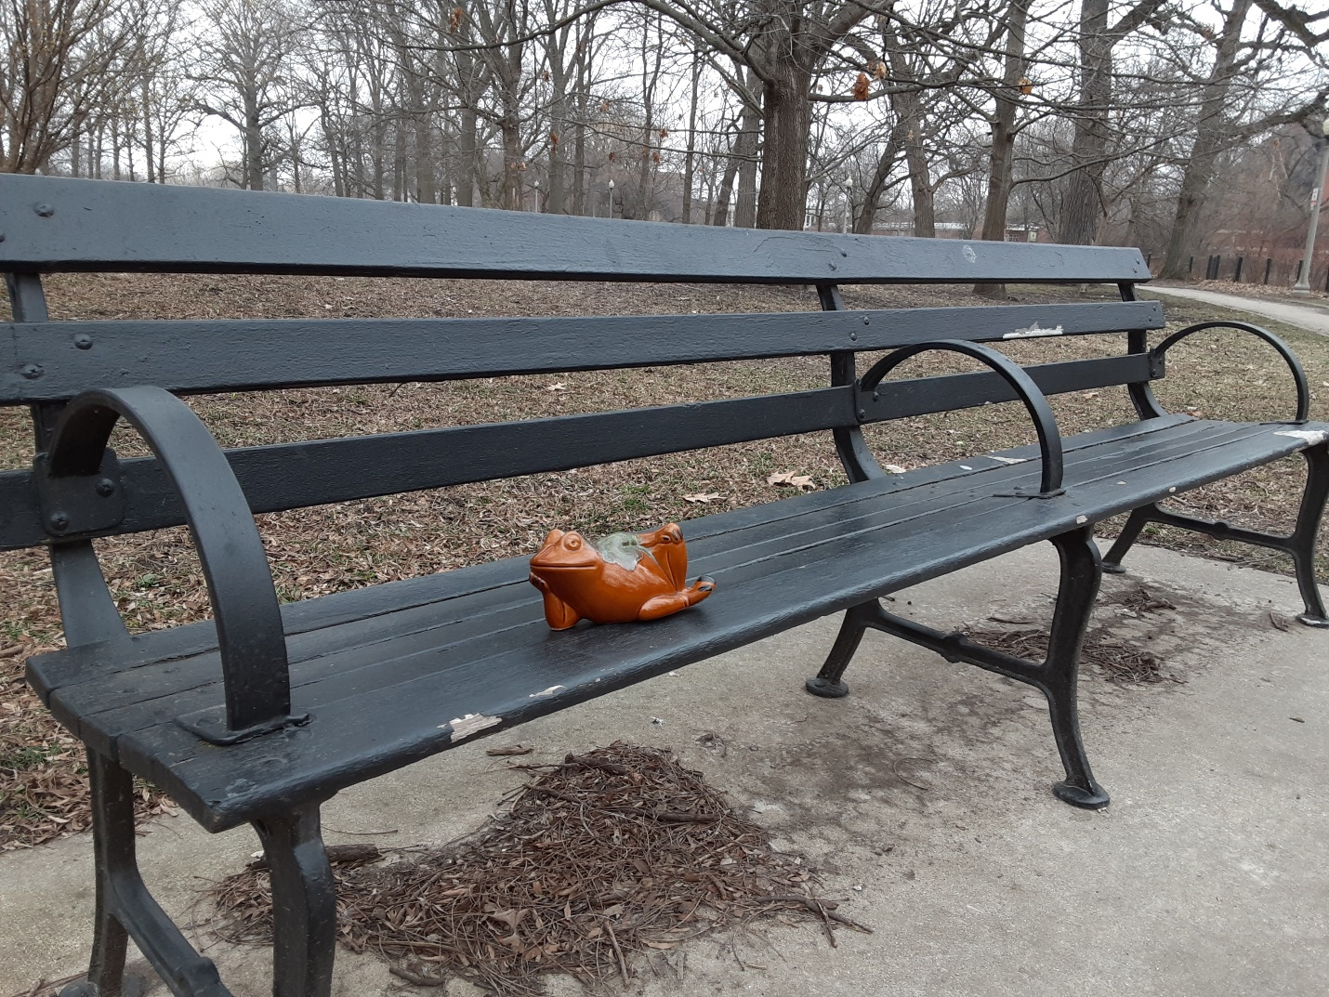
Oh, there he is! The frog had found another bench. Would I ever get close enough to catch him in my net?

Slide 14
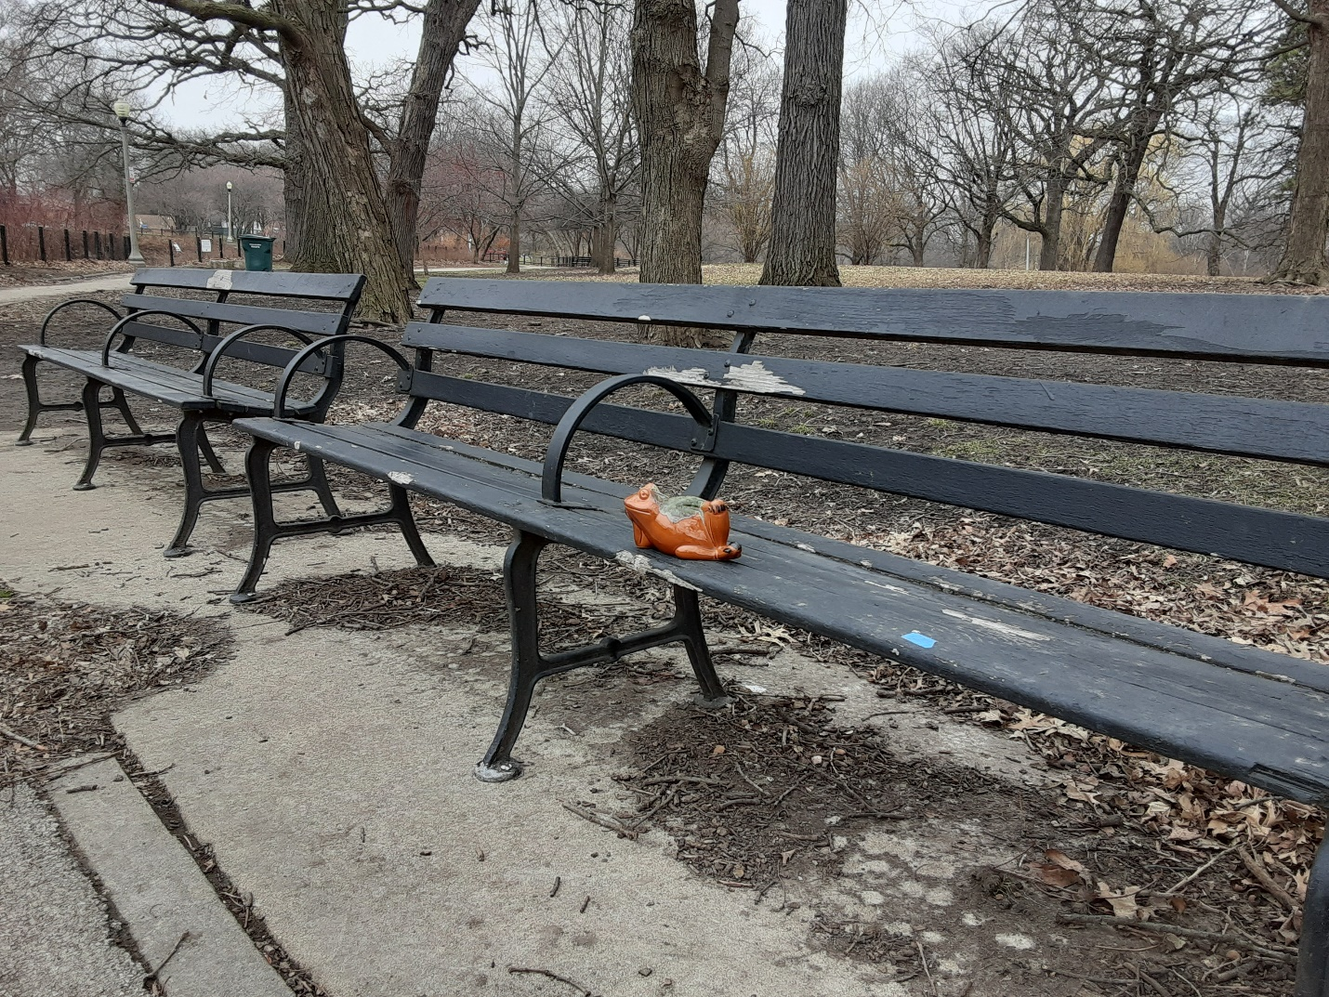
The frog sure enjoyed resting on benches before leaping away. He was always just out of my reach!

Slide 15
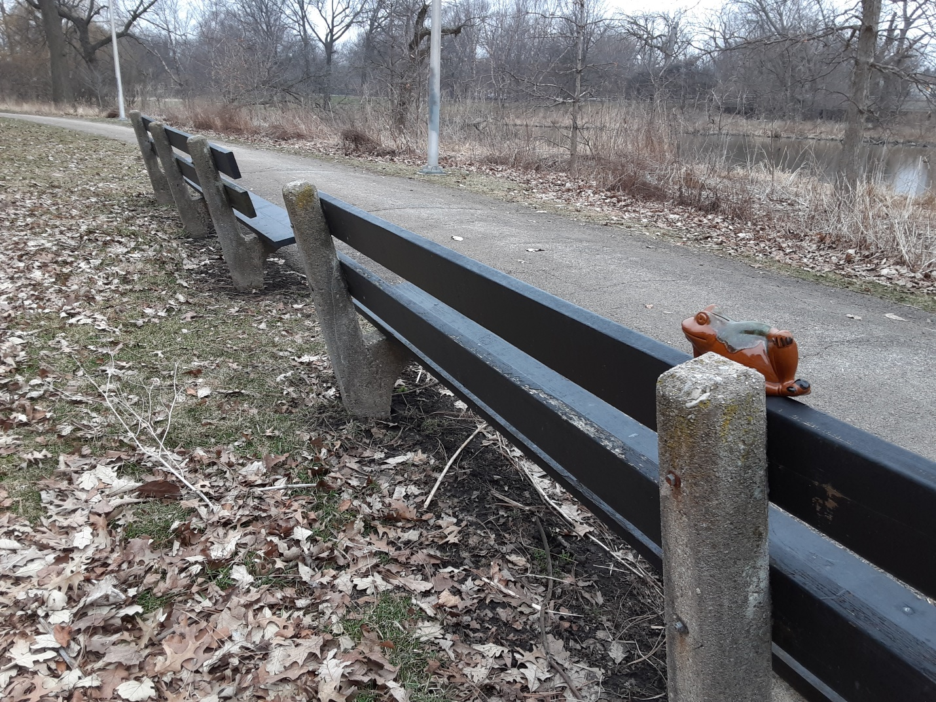
The last time I saw him, he bounced off a bench and into a pond. I think I heard the frog laughing as he splashed into the water.

Slide 16
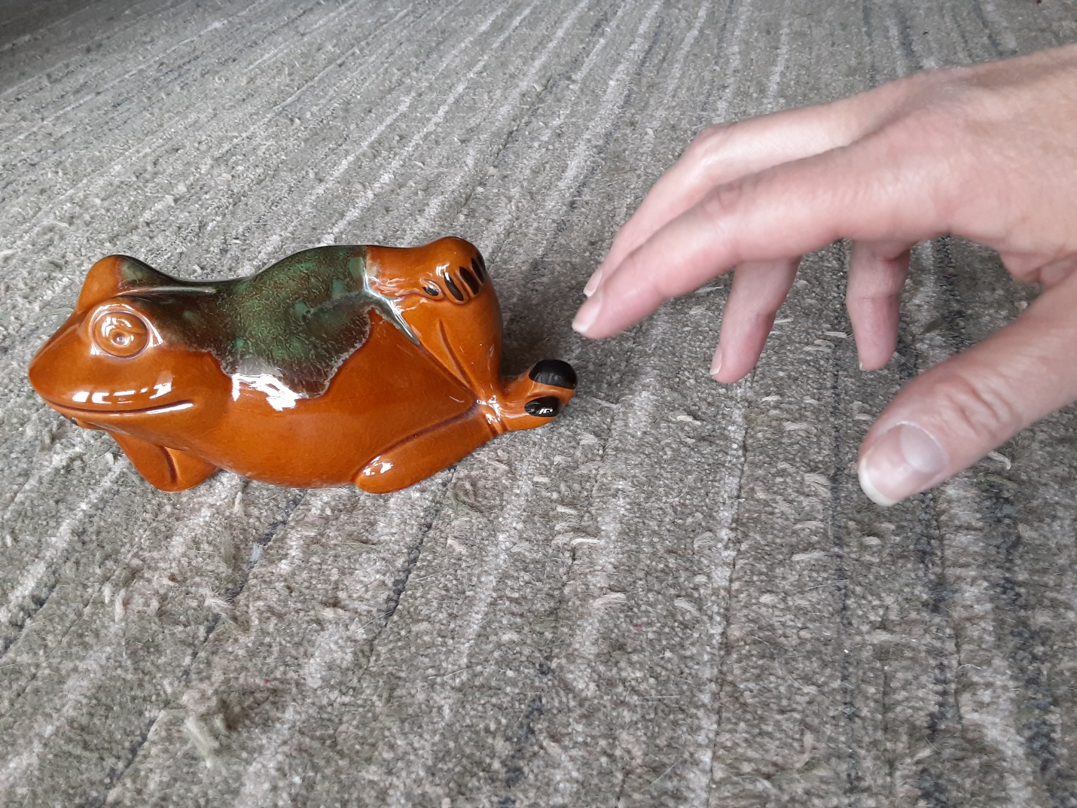
I tried to catch a frog today.
Maybe I will catch him tomorrow!

Slide 17
Ribbit!
The End

